Slide 1

Smart water fountain
Using IOT

Slide 2
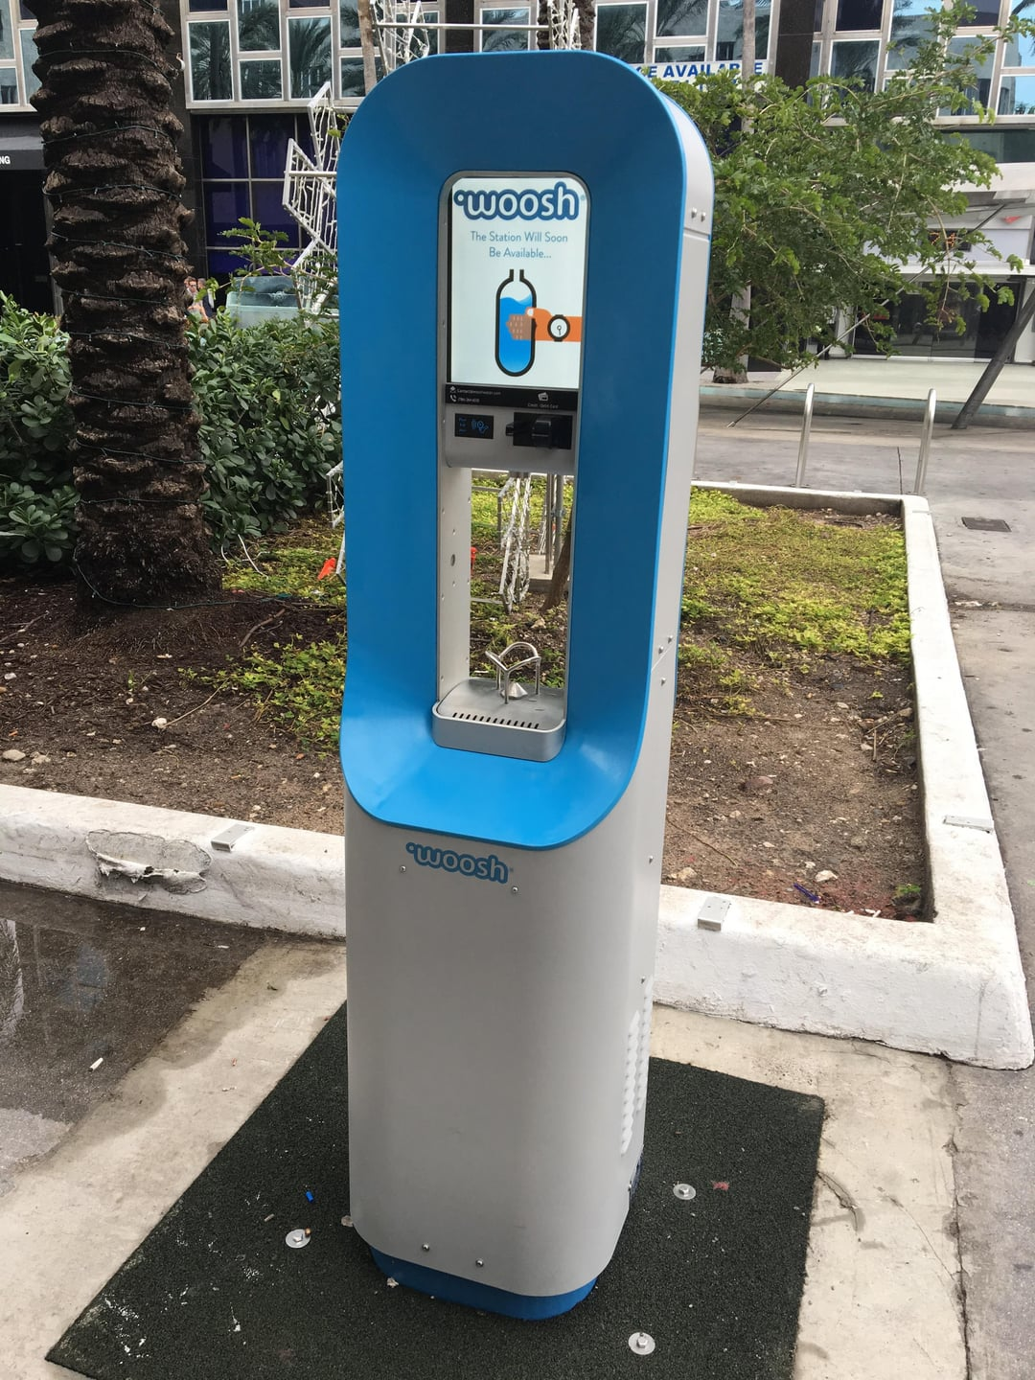
Introduction
The smart water fountain will be designed to conserve water and provide real-time monitoring and control using IoT technology. Users can control the fountain remotely through a mobile app or a web interface. The system will also incorporate sensors to monitor water levels, quality, and environmental conditions.

Slide 3
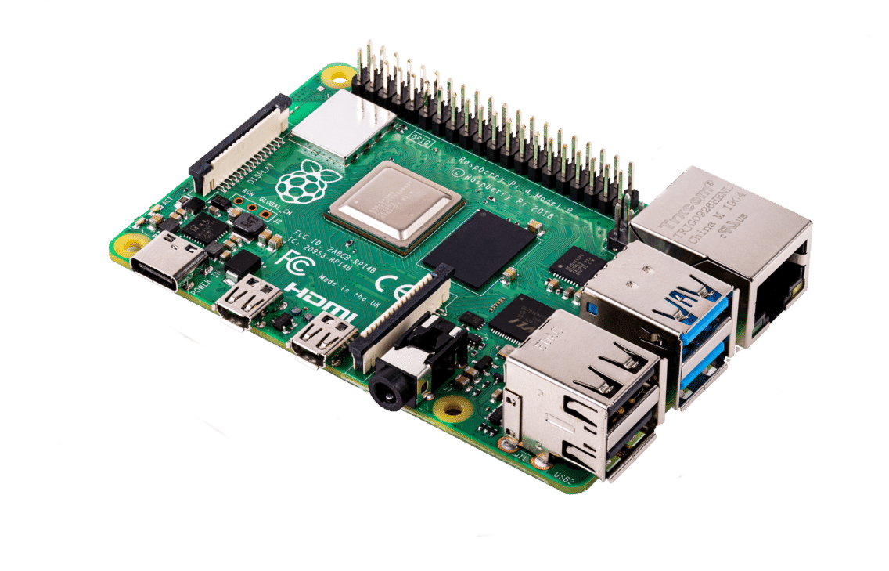
Components Needed
- IoT development board (e.g., Raspberry Pi, Arduino, or ESP8266)
- Water level sensors
- Flow sensors
- Water quality sensors (optional)
- Wi-Fi module or GSM module for connectivity
- Power supply
- Fountain control system (pumps, valves, etc.)
- Housing and casing

Slide 4
Assemble Process
Connect the sensors and control components to your IoT development board as per the manufacturer's instructions. Ensure that all connections are secure and functional.
Choose an IoT platform or cloud service to manage data from the sensors and provide real-time updates. Popular choices include AWS IoT, Google Cloud IoT, or Microsoft Azure IoT.
To write code for your IoT development board to:
Read data from the sensors (water level, flow rate, water quality, etc.)
Send this data to the IoT platform using MQTT, HTTP, or other suitable protocols.
Implement control logic for the fountain (e.g., turn on/off pumps based on water level).
Handle error conditions and generate alerts when necessary.

Slide 5
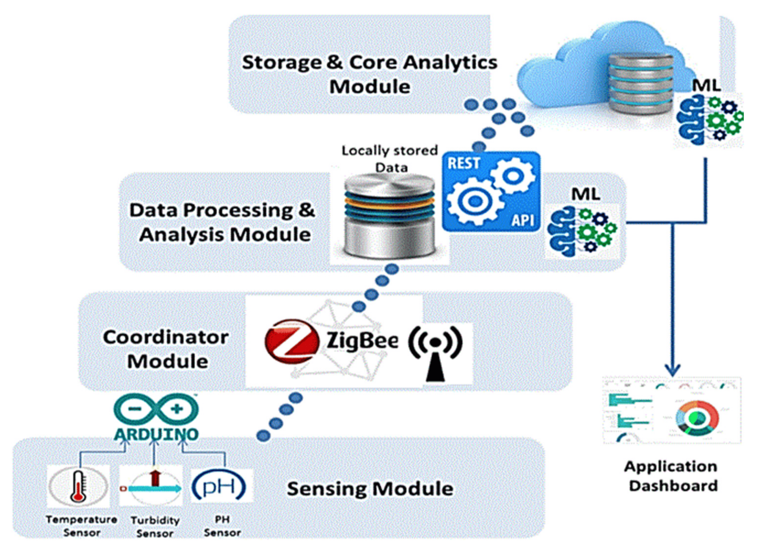

Slide 6
UI and Real-Time updates
Develop a user interface (UI) for users to access real-time information about the fountain. This could be a web dashboard, mobile app, or both.
The UI should display data such as water level, flow rate, water quality, and the status of the fountain.
Configure the IoT platform to provide real-time updates to the user interface. This might involve setting up data streaming, push notifications, or periodic polling of data.

Slide 7
Thank You

